Slide 1
Parallel Connected Components
The Parallelepipeds:
Fabian Meier
Gustavo Segovia
Seraiah Walter

Slide 2
Our goal
Develop a high performance algorithm for connected components
Graph fits in memory

Slide 3
Our goal
Develop a high performance algorithm for connected components
Graph fits in memory

Slide 4
Algorithms – Related work
Basic serial
Transversal (BFS/DFS) – O(n + m)
Union find – O(m log(n))
Boost
Serial
Parallel
Randomized Contraction Parallel Connected Components
http://www3.cs.stonybrook.edu/~rezaul/Spring-2012/CSE613/CSE613-lecture-11.pdf

Slide 5
Algorithms – Ours
Lock free parallel transversal
Parallel BFS
Parallel BFS with atomics
Parallel spanning tree – inspired by union find

Slide 6
Serial transversal

Slide 7
Serial transversal

Slide 8
Serial transversal

Slide 9
Serial transversal

Slide 10
Serial transversal

Slide 11
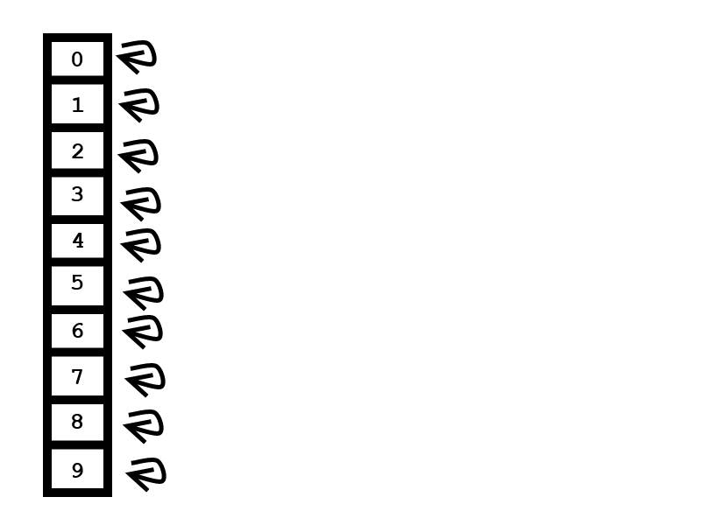
Union Find

Slide 12
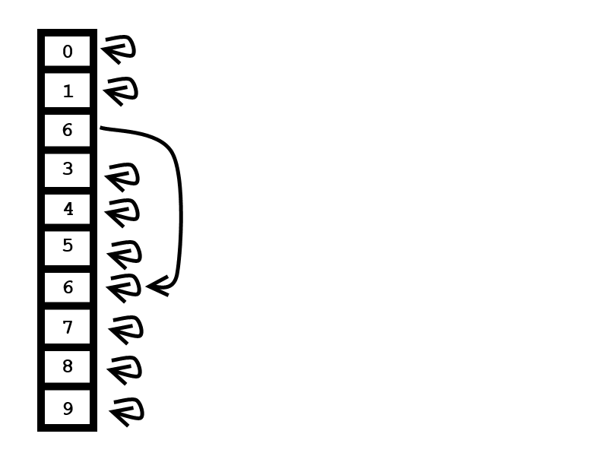
Union Find
edge 2-6

Slide 13
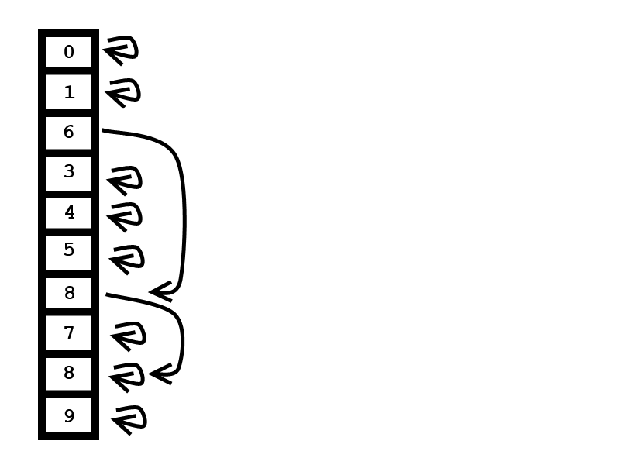
Union Find
edge 2-6
edge 2-8

Slide 14
Union find

Slide 15
Spanning Tree

Slide 16
Spanning Tree

Slide 17
Spanning Tree

Slide 18
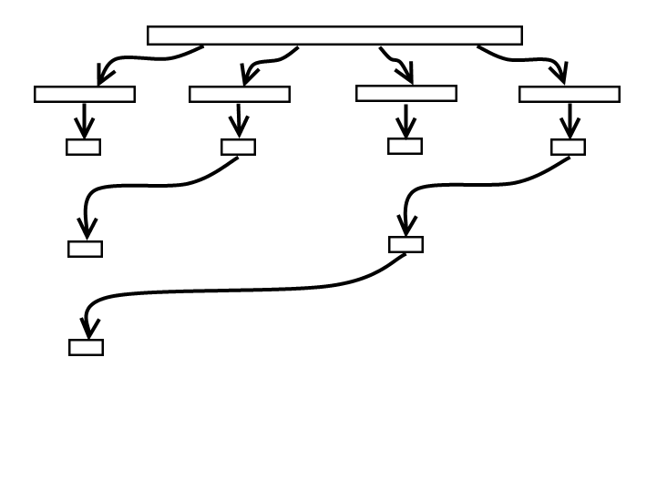
Spanning Tree
Runtime: O(m/p+ n*log(p))
Strong scaling in number of processors

Slide 19
Randomized Contraction
EXPLAIN IT

Slide 20
Randomized Contraction

Slide 21
Parallel transversal
EXPLAIN IT

Slide 22
Parallel transversal

Slide 23
Parallel transversal with atomics
EXPLAIN IT

Slide 24
Parallel transversal with atomics

Slide 25
Overview – Varying number of vertices

Slide 26
Overview – Varying number of components

Slide 27
Overview – Varying number of threads

Slide 28
Overview – Real world graphs

Slide 29
Lessons learned

Slide 30
Thank you

Slide 31
Explain the Algorithms
BFS
Iterate over all nodes
if not visited yet start bfs
pBFS
Each thread starts at a different node
If not visited yet start bfs
Mark nodes traversed by bfs with the same component number.
If encounter another number/thread put both number into merge list. Don’t follow nodes which are already marked.
At the end do merging of componenets
pBFSAtomic
Same as pBFS, guarantees that a write is seen by all other threads.
compareExchange
Similar to pBFS but no merging.
If two threads on the same component the one with lower priority drops its work and starts somewhere else.
Union find
Randomized contraction
Spanning tree

